Slide 1
ELEMENTARY STATISTICS, BLUMAN
Area Under Normal Curve Using Table (Example 1)
© 2019 McGraw-Hill Education. All rights reserved. Authorized only for instructor use in the classroom. No reproduction or further distribution permitted without the prior written consent of McGraw-Hill Education.

Slide 2
Objectives for this PowerPoint
Learn how to find probabilities associated with a normally distributed variable using the normal distribution table.

Slide 3

Example (1)
Using the standard normal distribution find the probability that a randomly selected standardized value from a normally distributed variable is between 0 and 0.95.
$$P(0<z<0.95)$$

Slide 4
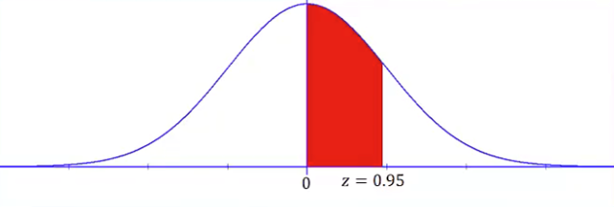
Example (2)
This can also be described as finding the area under the normal curve between the mean and 0.95 standard deviations to the right of the mean.

Slide 5
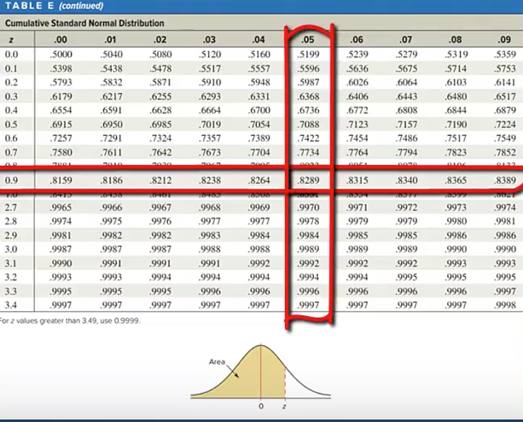
Example (3)
The cumulative standard normal distribution table gives us probabilities associated with z-scores. We are looking for the probability associated with the z score 0.95. We will find the entry in the table where the row 0.9 intersects with the column .05.
We find this value to be .8289

Slide 6
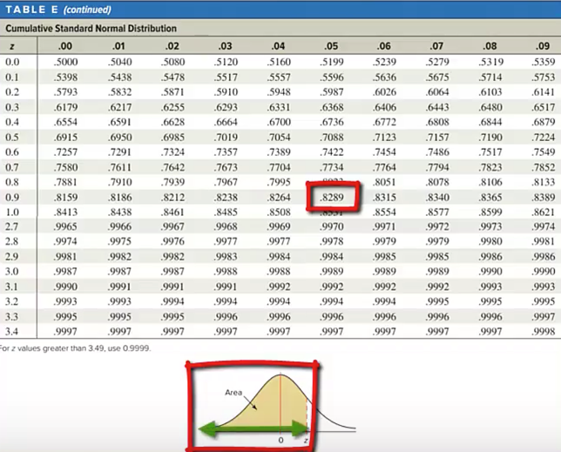
Example (4)
The graph at the bottom of the table shows that these 4 decimal place values in the body of the table correspond to the area under the curve that extends from the left-tail up to the z-score.

Slide 7
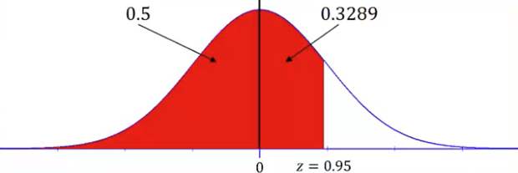
Example (5)
This value 0.8289 corresponds to the area under the curve that extends from the left-tail to the z-score 0.95. Our requested probability asks for the area that extends from the mean or in other words where the z-score is 0 up to the point where the z-score is 0.95.

Slide 8
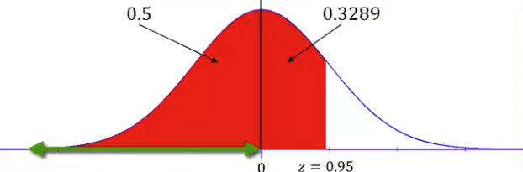
Example (6)
Since the normal distribution since the normal distribution the area under the normal curve from the left-tail up to the mean where the z-score is 0 is 0.5 or in other words half of the distribution.

Slide 9
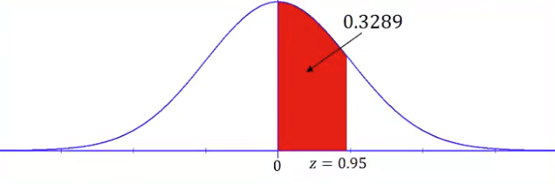
Example (7)
That would leave 0.3289 as the area under the curve from the mean where the z-score is equal to 0 up to that point where the z-score is 0.95. The area that we are looking for is 0.3289.

Slide 10

Example (8)
In probability notation we would write the probability that z is between 0 and 0.95 is equal to 0.8289 minus 0.5 is equal to 0.3289.
$$P\left(0<z<0.95\right)=0.8289−0.5=0.3289$$

Slide 11
Summary
In this PowerPoint we learned how to find probabilities associated with a normally distributed variable using the normal distribution table.

